Slide 1
Deepening understanding with fractions of a given amount
Understanding multiplicative relationships: fractions and ratio

Slide 2
how to use Oak lessons

Slide 3
I can find the original amount when given a fraction and the result.

Slide 4
The reciprocal is the multiplicative inverse of any non-zero number. Any non-zero number multiplied by its reciprocal is equal to 1.

Slide 5

Deepening understanding with fractions of a given amount
Bar models to find the original amount
Using double number lines
Finding the original amount using division

Slide 6

Bar models to find the original amount
Alex gives of his sweets to his brother.
His brother gets 15 sweets.
How many sweets did Alex have to begin with?
We can represent this problem with a bar model.
15 ÷ 3 = 5
5
5
5
5
5
5
5
5
8 × 5 = 40
Alex originally had 40 sweets.

Slide 7



Bar models to find the original amount
The special offer box contains 600 grams.
How heavy is the box usually?
Special Offer
extra free
extra
normal size
600 g = of the usual . weight.
g

Slide 8
Bar models to find the original amount
The special offer box contains 600 grams.
How heavy is the box usually?
600 g ÷ 6 = 100g
100 g
100 g
100 g
100 g
100 g
100 g
5 × 100 g = 500 g
The box is usually 500 g.

Slide 9

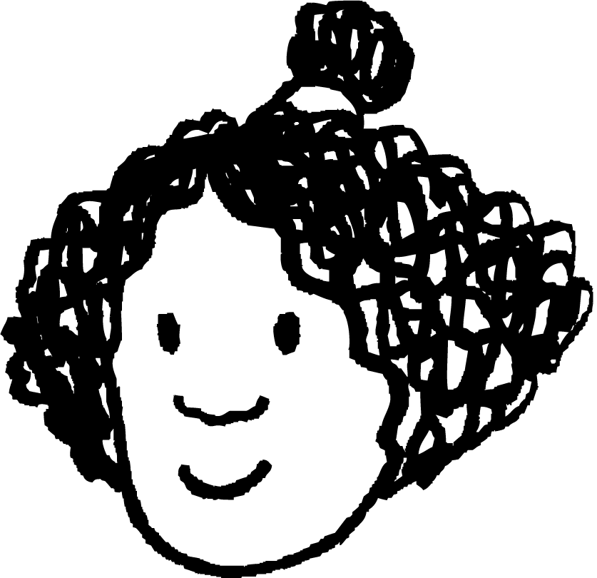
Bar models to find the original amount
Izzy is saving for a new computer game.
When Izzy has saved enough money to buy the game she notices that the price has increased by to £49.
Her mum gives her the extra money to buy the game.
How much had Izzy saved?
Izzy

Slide 10
Bar models to find the original amount
What would a bar model look like to represent this situation?
Izzy saved the original cost and her mum gave her
1
£7
£7
£7
£7
£7
£7
£7
£7 × 5 = £35
£49 ÷ 7 = £7
original price
new price
Izzy saved £35.
Izzy

Slide 11
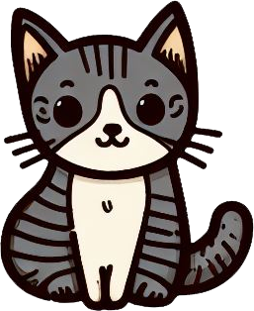

Bar models to find the original amount
Alex’s cat goes to the vet once a year.
The vet tells Alex that his cat has lost of its mass.
His cat now has a mass of 4.5 kg.
What was the mass of Alex’s cat last year?
new mass
4.5 kg ÷ 5 = 0.9 kg
0.9 kg
0.9 kg
0.9 kg
0.9 kg
0.9 kg
0.9 kg
0.9 kg
0.9 kg × 7 = 6.3 kg
original mass
Alex’s cat had a mass of 6.3 kg last year.

Slide 12

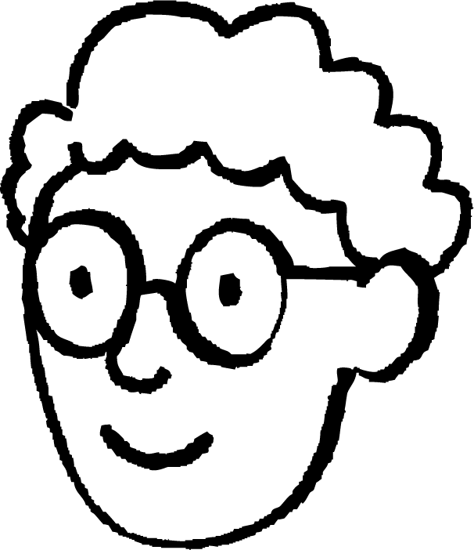
Bar models to find the original amount
A sunflower increases its height in one month by of its original height. It now measures 1.4 m.
How tall was it at the beginning of the month?
Who has drawn the correct bar model?
?
?
1.4 m
1.4 m
Alex has drawn the correct bar model.
Izzy’s shows a decrease of
Alex
Izzy

Slide 13

Bar models to find the original amount
You buy a sweatshirt in this sale.
You pay £30.
How much was it originally?
SALE off
You buy a sweatshirt in this sale.
You pay £50.
How much was it originally?
£30 ÷ 2 = £15
£50 ÷ 2 = £25
3 × £15 = £45
3 × £25 = £75

Slide 14
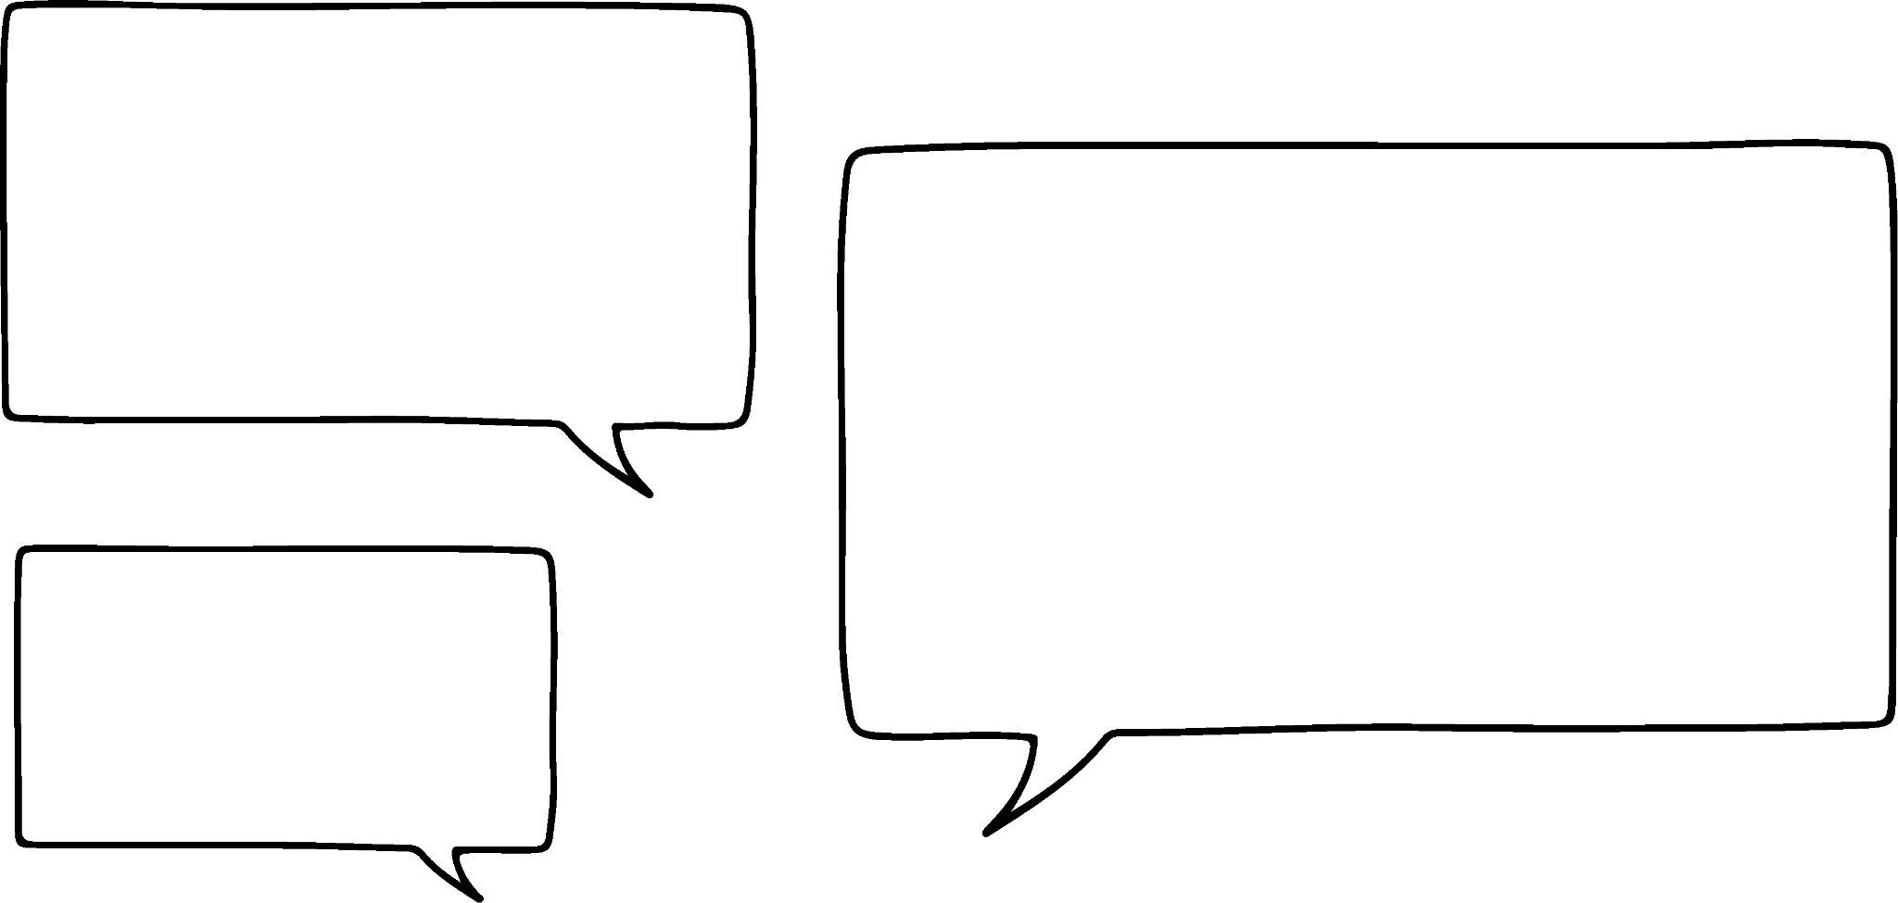
Bar models to find the original amount
Alex and Izzy are trying to decide if the following is true without working out the answers.
of 150 = of 75
150
It must be false. Both the fraction and amount are smaller so the answer must be smaller.
75
I think it is true. The fraction and amount have both halved.
Alex
We can see from the bar models that it is false.
Izzy

Slide 15

Bar models to find the original amount
80
of 80 = of 160
40
So, because we halved the fraction we had to double the amount.
160
Alex

Slide 16
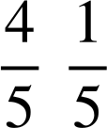
Bar models to find the original amount
of 250 = of 1000
250
250
250
250
I think that here we have divided the fraction by 4 so we must have to multiply the amount by 4.
4 × 250 = 1000
Yes, I think you are right Alex.
Alex
Izzy

Slide 17
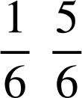
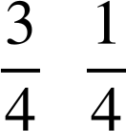
Bar models to find the original amount
× 5
÷ 3
of 240 = of 48
of 15 = of 45
÷ 5
× 3

Slide 18
Bar models to find the original amount
Match each problem to the correct bar model and solve.
Izzy is saving for a new camera. She has saved £42 which is two-fifths of the cost. How much does the camera cost?
A packet of crisps contains two-fifths extra free; it weighs 42 grams. How heavy is the normal packet?
Alex buys a sweatshirt in a sale saving you two-fifths. It cost him £42. How much was it before the sale?
42
42
42

Slide 19
Bar models to find the original amount
Match each problem to the correct bar model and solve.
Izzy is saving for a new camera. She has saved £42 which is two-fifths of the cost. How much does the camera cost?
A packet of crisps contains two-fifths extra free; it weighs 42 grams. How heavy is the normal packet?
Alex buys a sweatshirt in a sale saving you two-fifths. It cost him £42. How much was it before the sale?
b)
42
a)
42
c)
42
6
21
14
30 g
£105
£70

Slide 20
Deepening understanding with fractions of a given amount
Bar models to find the original amount
Using double number lines
Finding the original amount using division

Slide 21


Using double number lines
I think of a number.
of my number is 28
What is my number?
What is the multiplicative relationship between and 1?
×
We know that this is the reciprocal of which is .
1
Fraction
Number
28
63
?
I was thinking of 63.
×

Slide 22


Using double number lines
We can also use double number lines to find the original amount.
We will go back and use one of our examples from earlier.
The vet tells Alex that his cat has lost of its mass.
His cat now has a mass of 4.5 kg.
What was the mass of Alex’s cat last year?
×
1
What fraction of the cat’s original mass is it now?
Fraction
Mass (kg)
lost
?
4.5
6.3
It is now of the original mass.
×

Slide 23
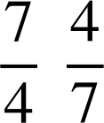

Using double number lines
Alex has been challenging himself each week to complete as many times tables questions as he can in 2 minutes.
Over the last year he has improved his score by three-quarters.
His score is now 140
What was his score at the beginning of the year?
×
1
Fraction
Score
?
140
80
×

Slide 24

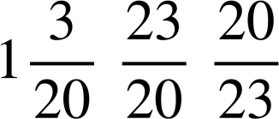
Using double number lines
Spot the mistake.
The cost of a laptop increases by
It now costs £460.
How much did it cost before the increase?
×
1
Just looking at the answer of £529, how could you tell that it was wrong?
Fraction
Cost (£)
The price of the laptop had increased, therefore the original price must have been lower.
529
£460
£400
×
÷

Slide 25
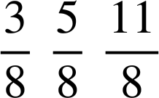
Using double number lines
Match each problem to its double number line and solve.
The price of a camera increases by three-eighths to £165. How much did it cost before the increase?
Alex takes part in a spelling competition. He gets 165 right. This is three-eighths of the questions. How many questions were in the competition?
A multi-buy offer gives a discount of three-eighths. If you pay £165, how much is it without the discount?
1
1
1
Fraction
Fraction
Fraction
Amount
Amount
Amount
165
165
165

Slide 26
Using double number lines
Match each problem to its double number line and solve.
The price of a camera increases by three-eighths to £165. How much did it cost before the increase?
Alex takes part in a spelling competition. He gets 165 right. This is three-eighths of the questions. How many questions were in the competition?
A multi-buy offer gives a discount of three-eighths. If you pay £165, how much is it without the discount?
b)
c)
a)
1
1
1
Fraction
Fraction
Fraction
Amount
Amount
Amount
165
440 questions
165
£264
£120
165

Slide 27
Deepening understanding with fractions of a given amount
Bar models to find the original amount
Using double number lines
Finding the original amount using division

Slide 28

Finding the original amount using division
What is of 60?
REMEMBER: the word ‘of’ and the process of multiplying are the same in maths.
36 ÷ 60 =
96 ÷ =
× 60 = 36
× 160 = 96
36 ÷ = 60
96 ÷ =
Which of these is most useful for finding the value of the cloud?

Slide 29
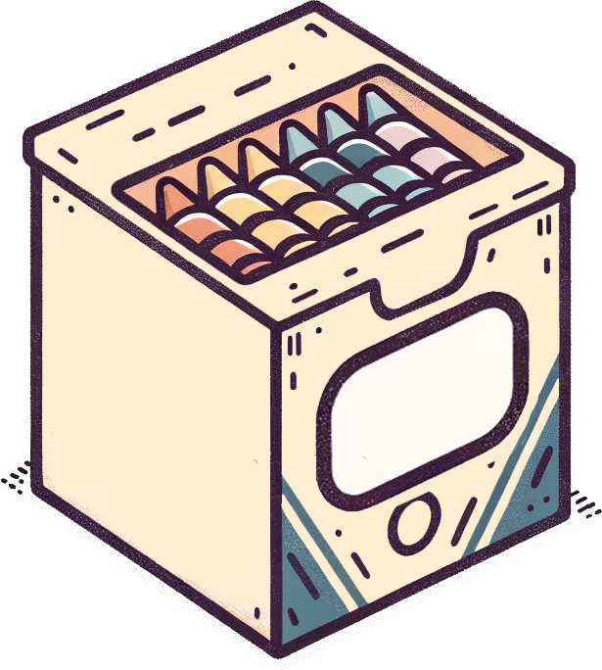
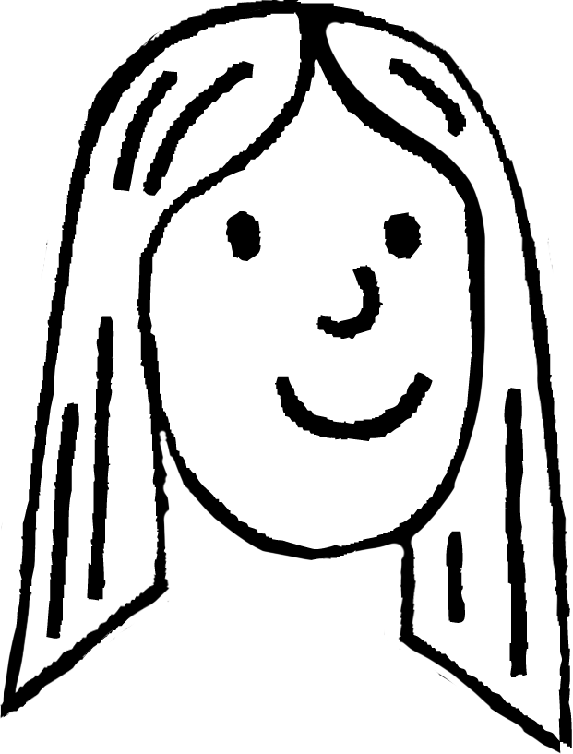


Finding the original amount using division
Laura notices that some of her crayons are broken.
Two-sevenths of the crayons are broken.
How many crayons are in the box?
4 of my crayons are broken.
× c = 4 crayons
c = 4 ÷ = 4 × = = 14
Laura

Slide 30


Finding the original amount using division
Jun did a sponsored walk.
He gave £150 to his favourite charity. This was three-fifths of the total he raised.
How much money did Jun raise in total?
t = £150 ÷
× t = £150
t = £150 × = £50 × 5 = £250
Jun raised £250 in total.
Jun

Slide 31

Finding the original amount using division
The mass of the special offer box is 900 grams.
What is the mass of a normal box?
Special Offer
extra free
× w = 900
w = 900 ÷ = 750 g
900 g
The normal box weighs 750 g.

Slide 32
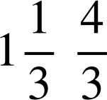
Finding the original amount using division
Special Offer
extra free
A special offer bag of sweets weighs 320 grams.
How heavy is the bag usually?
A special offer bag of sweets weighs 200 grams.
How heavy is the bag usually?
× w = 320 g
× w = 200 g
w = 320 ÷ = 240 g
w = 200 ÷ = 150 g

Slide 33
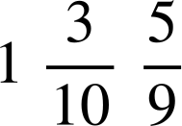


Finding the original amount using division
Jun gives £195 of his sponsorship money to his favourite charity; this is three-quarters of the total. How much money did Jun raise in total?
A shop has a sale saving you one-third. Laura buys a t-shirt for £28. How much was it at full price?
Alex improves his score on a computer game by two-sevenths. His improved score is 3204. What was his previous score?
of 60 = of 140.4
of 33x = of 8x
What number is the square covering?
What term is the square covering?

Slide 34
Finding the original amount using division
Jun gives £195 of his sponsorship money to his favourite charity; this is three-quarters of the total. How much money did Jun raise in total? £260
A shop has a sale saving you one-third. Laura buys a t-shirt for £28. How much was it at full price? £42
Alex improves his score on a computer game by two-sevenths. His improved score is 3204. What was his previous score? 2492
of 60 = of 140.4
of 33x = of 8x
What number is the square covering?
What term is the square covering?

Slide 35
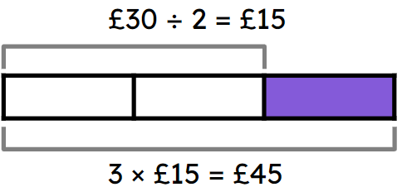
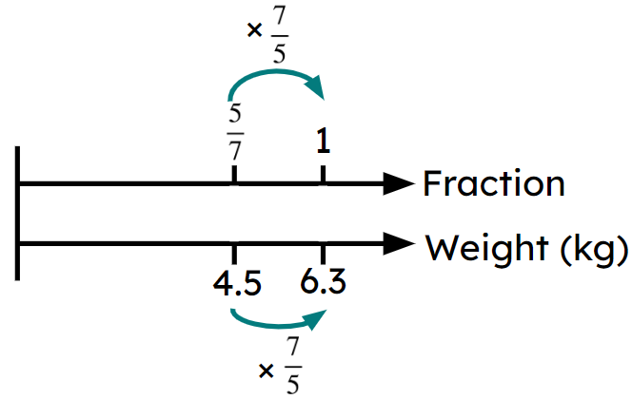
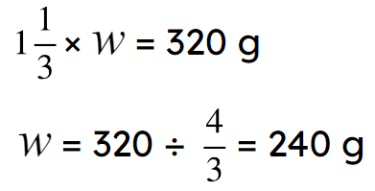
Deepening understanding with fractions of a given amount
Bar models can be used to find the original amount in fraction problems. E.g.
Double number lines can be used to find the original amount in fraction problems. E.g.
Division can be used to find the original amount in fraction problems. E.g.

Slide 36

© Oak National Academy 2023.
Produced in partnership with Mathematics in Education and Industry.
Licensed on the Open Government Licence v3.0, except where otherwise stated. See Oak terms and conditions.

